Slide 1
Building a Credible, Open-Source High-Fidelity Computational Fluid Dynamics Tool Suitable for Renewable Wave Energy Applications
Stefan P. Domino^{1,2}
¹ Computational Thermal and Fluid Mechanics, Sandia National Laboratories
² Institute for Computational and Mathematical Engineering, Stanford
December 2nd, 2022
Stanford’s Center for Turbulence Research Tea Seminar Series
SAND2022-15987 PE

Slide 2
Presentation Objectives
Background
Essential Attributes for a Wave Energy Converter Mod/Sim Tool:
Low-Mach numerical approach that efficiently manages complex geometries
Design-order
Efficient/Scalable
Three Numerical Regimes:
Fluid Mechanics
Volume of Fluid (VOF)
Mesh Movement
Presentation Themes Include:
Numerical Methods Development
Verification
Validation
Objective: Establish Credibility

Slide 3

Acknowledgements
Wyatt Horne, Computational Thermal and Fluid Mechanics (1541)
Leveraged six-DOF + Overset expertise
Team member, co-author
Sandia’s Advanced Scientific Computing (ASC)
Exascale Computing Project
Water Power Technologies Department (8922); staff Jesse Roberts and Chris Chartrand
Stanford CTR and ICME, including:
Professor Parviz Moin,
Susan Dorman, and
Mikayla Booker
( )
PSAAP-2

Slide 4
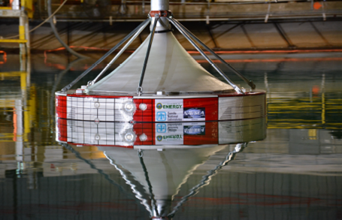
Approaches for Harnessing Energy from Waves
Generally, three types of wave energy converters (WEC) designs:
Point Absorbers: floating or submerged objects drive energy production (solid/wave coupling with mooring, i.e., tether)
Attenuators: Hinged joints whose motion drives a energy generation (multi-body/wave challenge)
Oscillating Water Column (OWC): Wave motion displaces air and drives a turbine (wave/turbine coupling)
Hybrids exist as well
Positive attributes include:
High uptime (90%)
Energy density of 2-3 kW/m²
Our numerical formulation will target point absorbers with applications to OWC
Coe et al., SAND2016-10094

Slide 5
Presentation Components Overview: Credibility (Separate)
1. Fluid Mechanics
2. Volume of Fluid
3. Moving Meshes

Slide 6
Presentation Components Objective: Credibility (Union)
1. Fluid Mechanics
2. Volume of Fluid
3. Moving Meshes

Slide 7
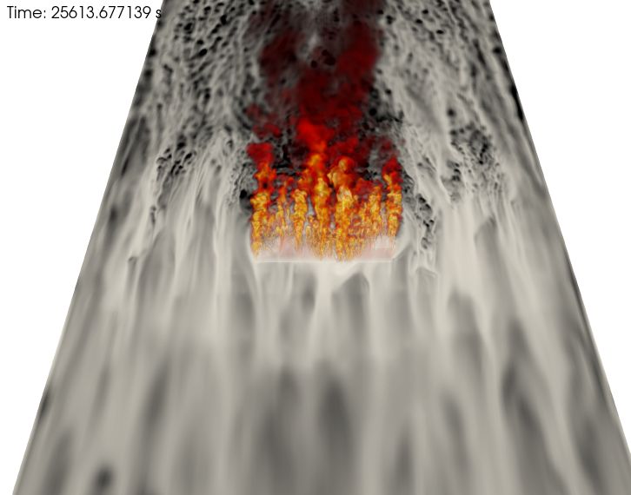
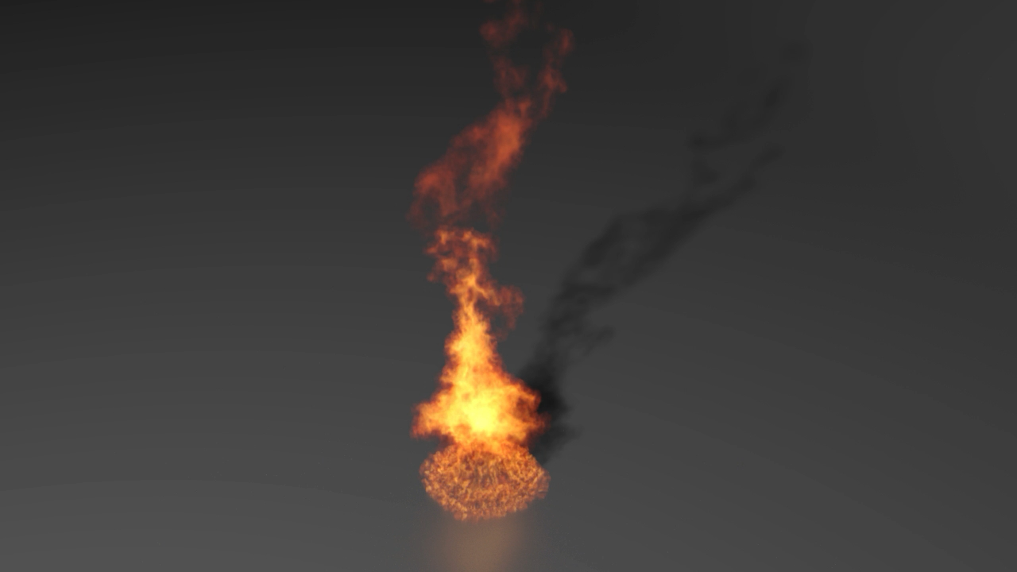
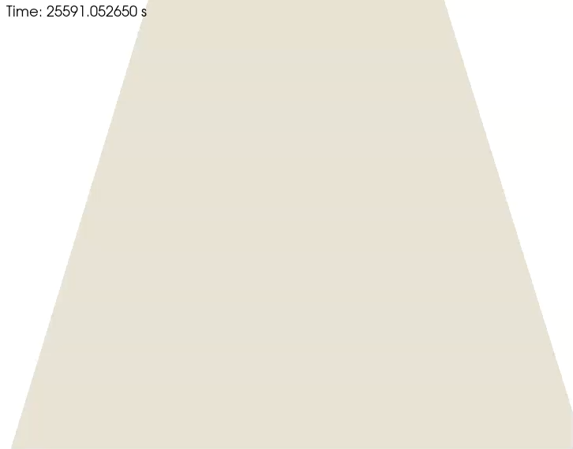
Leverage Long-standing Variable-Density low-Mach LES-based Technologies Sierra Fuego (export control) & Nalu BSD-3, https://github.com/NaluCFD
Core Algorithm: Equal-order interpolation, incremental pressure projection scheme, Domino, J. Comput. Phys. (2018); lineage to Domino, CTRSP (2006)
15mx5m JP-8 (crosswind) based
on configuration from Scott and
Domino, Flow (2022)
5 meter JP-8 (quiescent), Domino et al., Phys. Fluids (2021)
(thank you to B. Carvey for volume-rendered visualization)

Slide 8
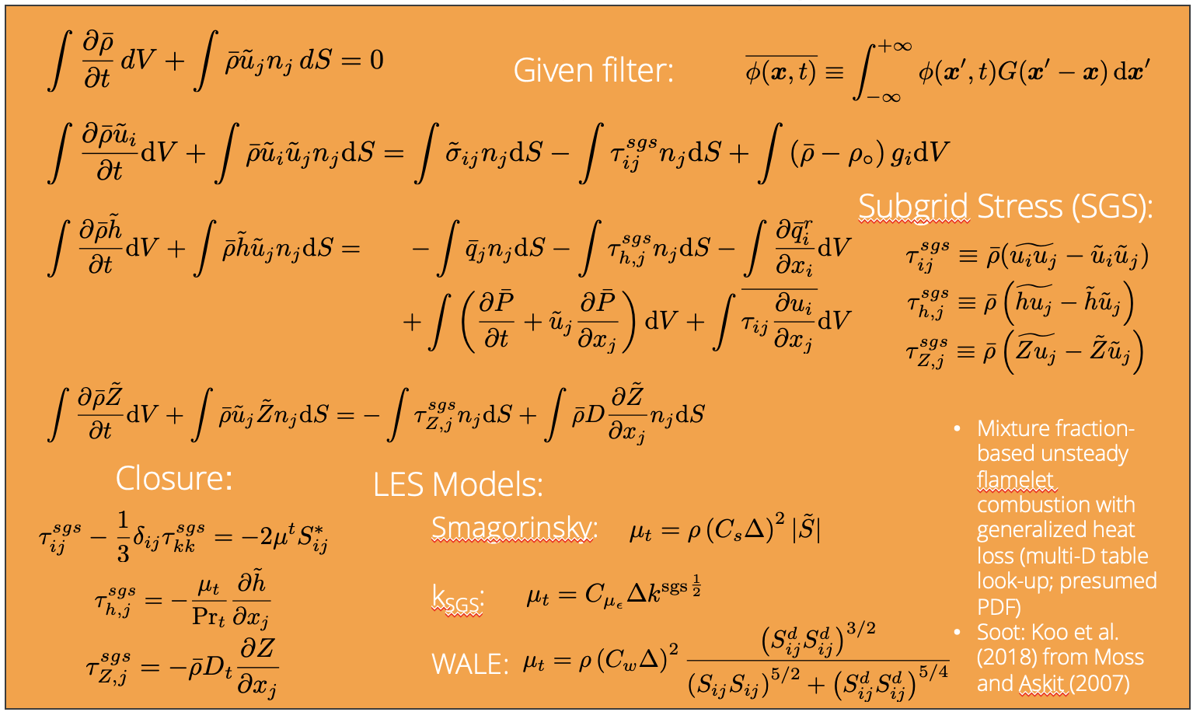
Fire Mechanics Coupling Description: Equations
Favre-averaged, variable-density, low-Mach equation set using large-eddy simulation (LES): equal-order, incremental, approximate pressure projection scheme

Slide 9
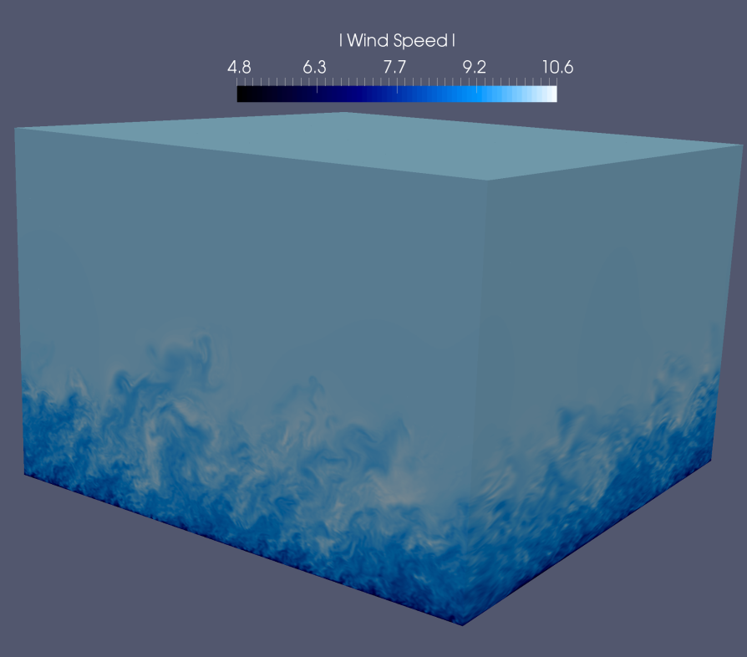
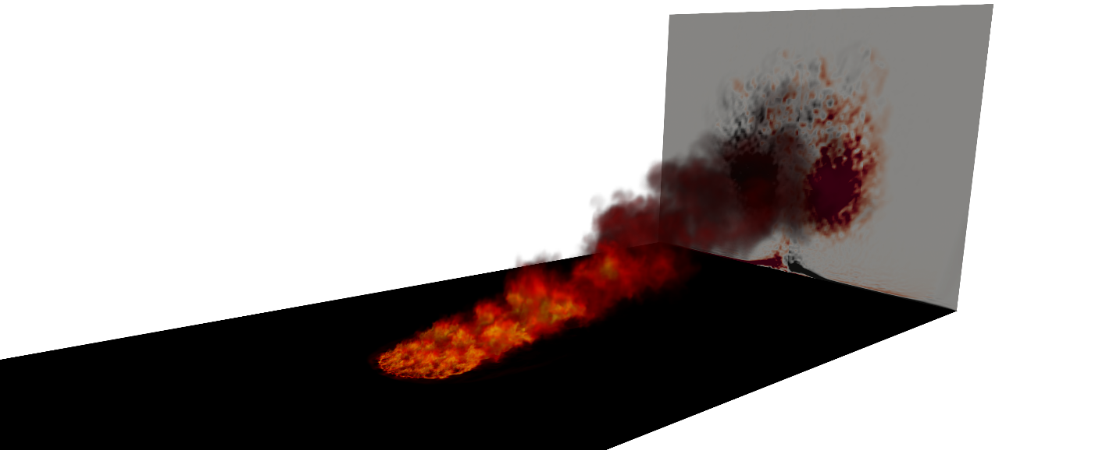
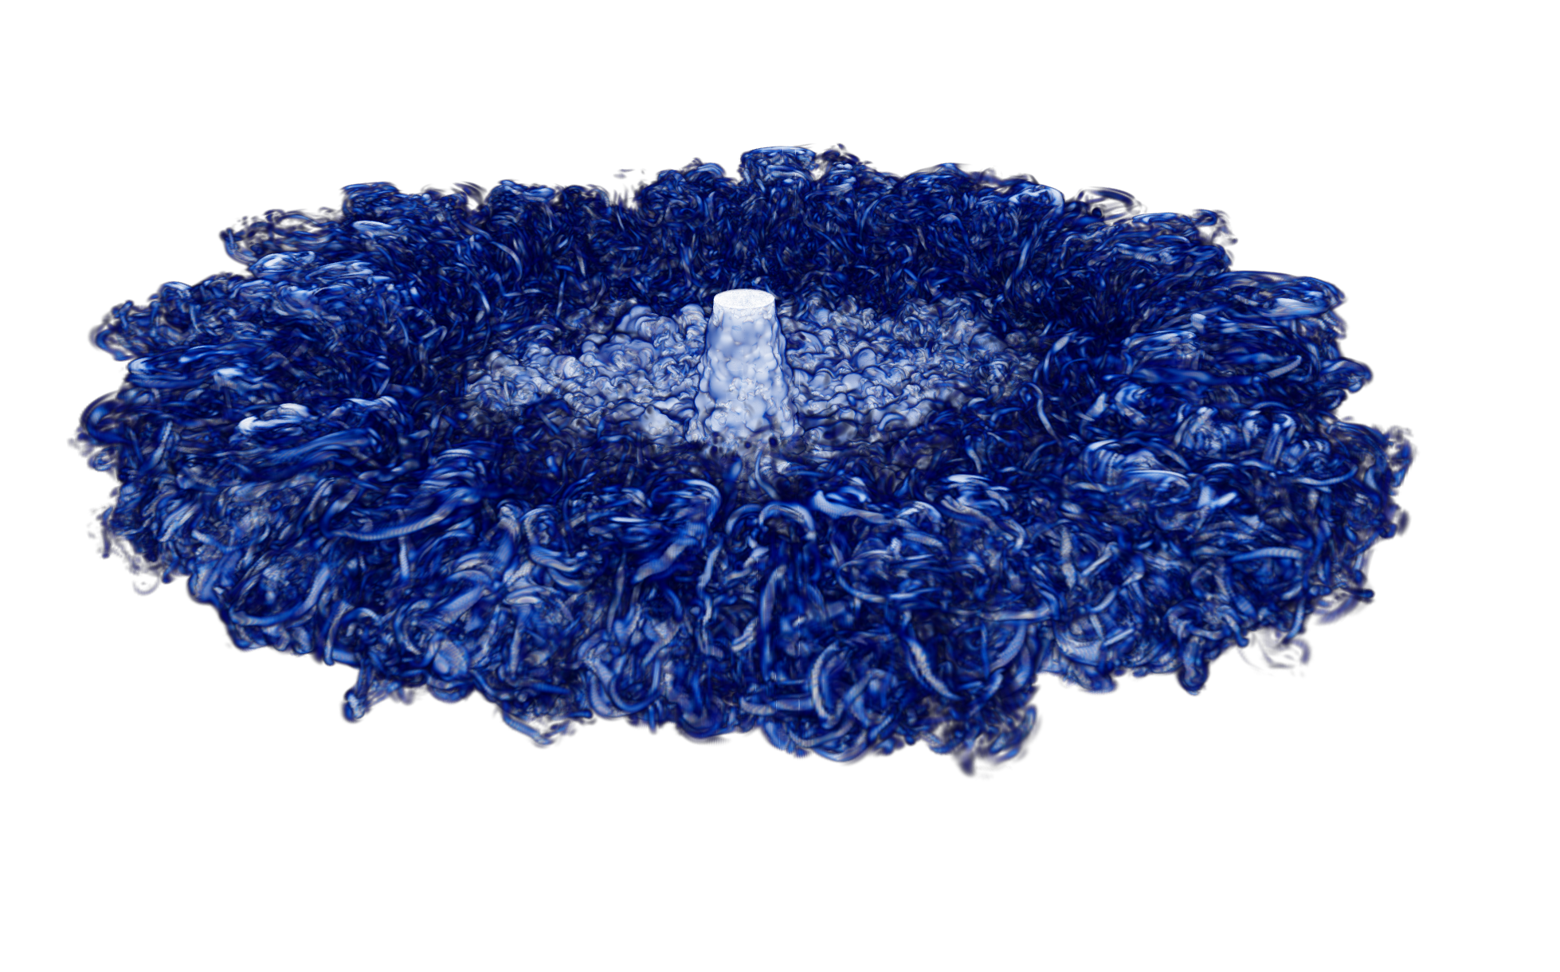
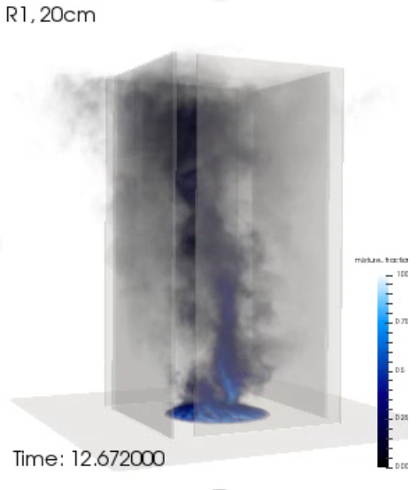
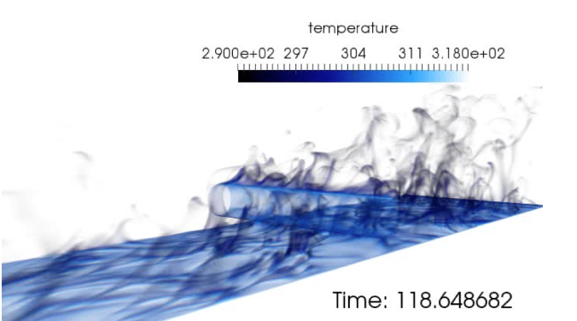
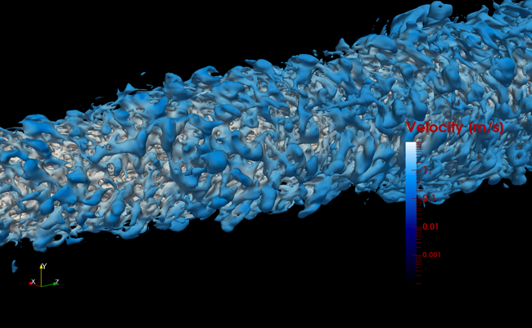
Many Complex Applications: Multi-physics, Static-Mesh

Slide 10

Developed Open-Source BSD-clause 3 Distribution Policy
Unstructured; multiphysics
Control volume finite element (CVFEM); 2nd and 3rd –order spatial accuracy (SA)
Edge-based vertex-centered (EBVC); 2nd SA
Finite element method (FEM), 3rd SA (Tet10)
Implicit, variable-density, low-Mach; explicit ASUM-based Compressible (with overset and sliding mesh)
Exercised in Me469, “Computational Methods in Fluid Mechanics” as a pedagogical tool
A wide range of applications from wave to mitral valve regurgitation! - Lee et al., Int. J. Cardiovasc. Imaging (2022)
OpenFOAM alternative, however, not viewed as a competition
Philosophy: Open-source collaborations
Philosophy: Open-source collaborations
https://github.com/NaluCFD
Academic Partners:

Slide 11
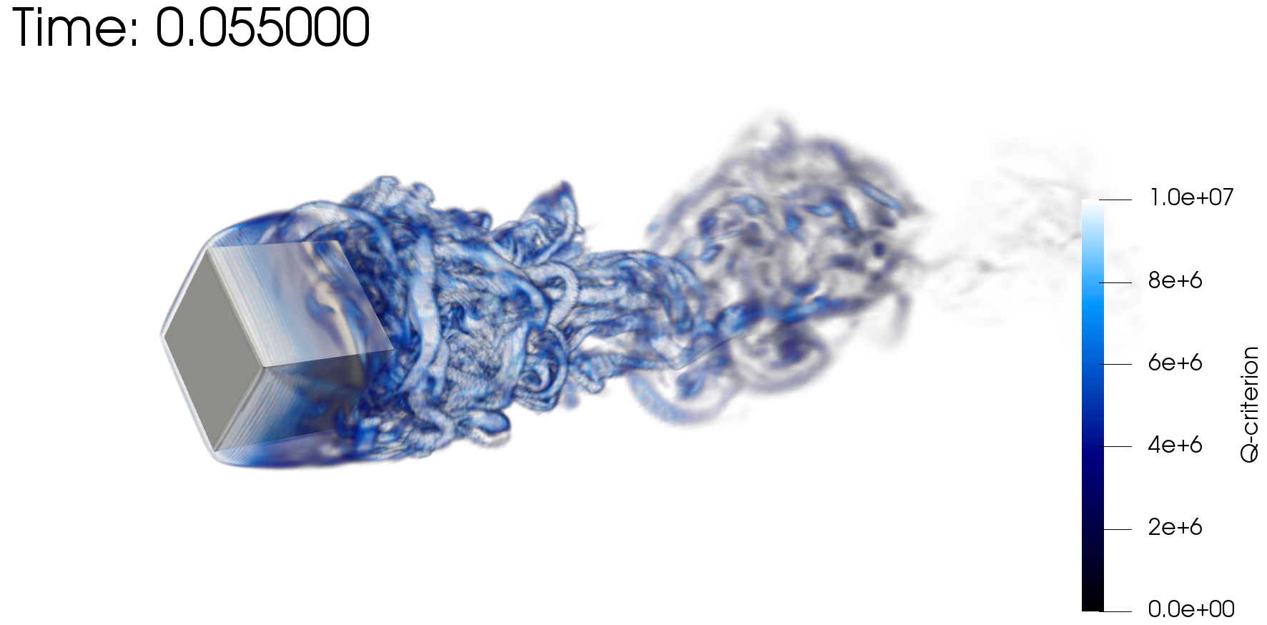
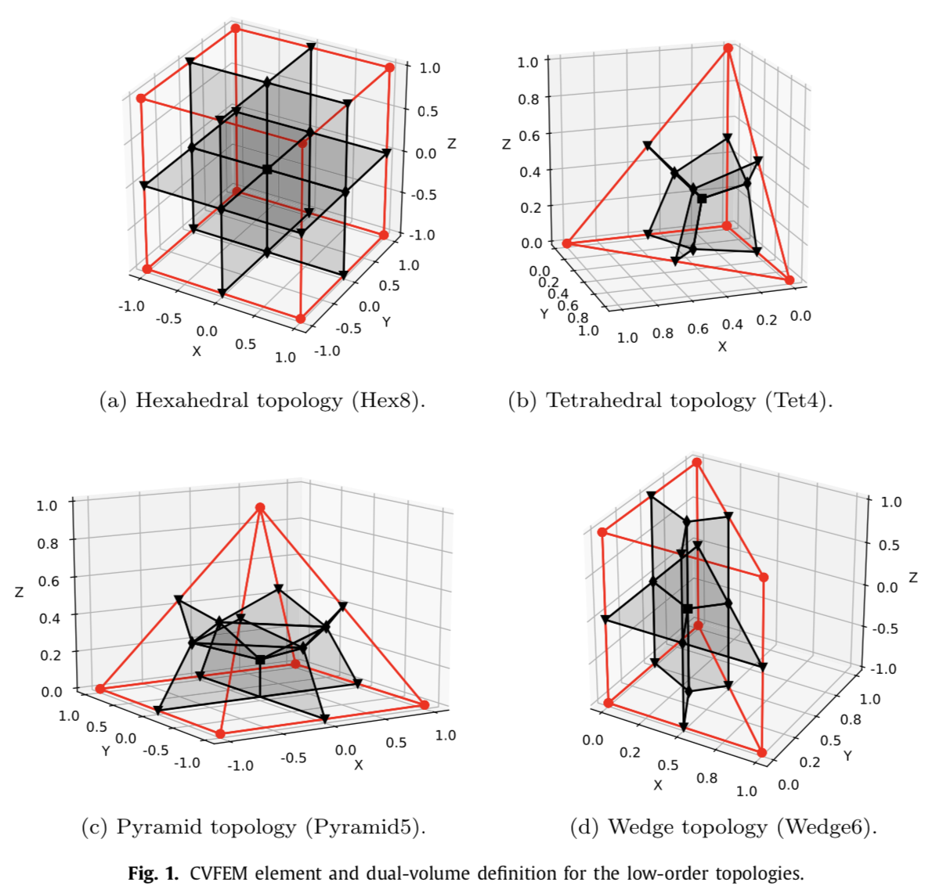
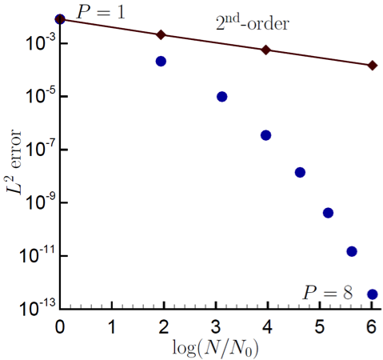
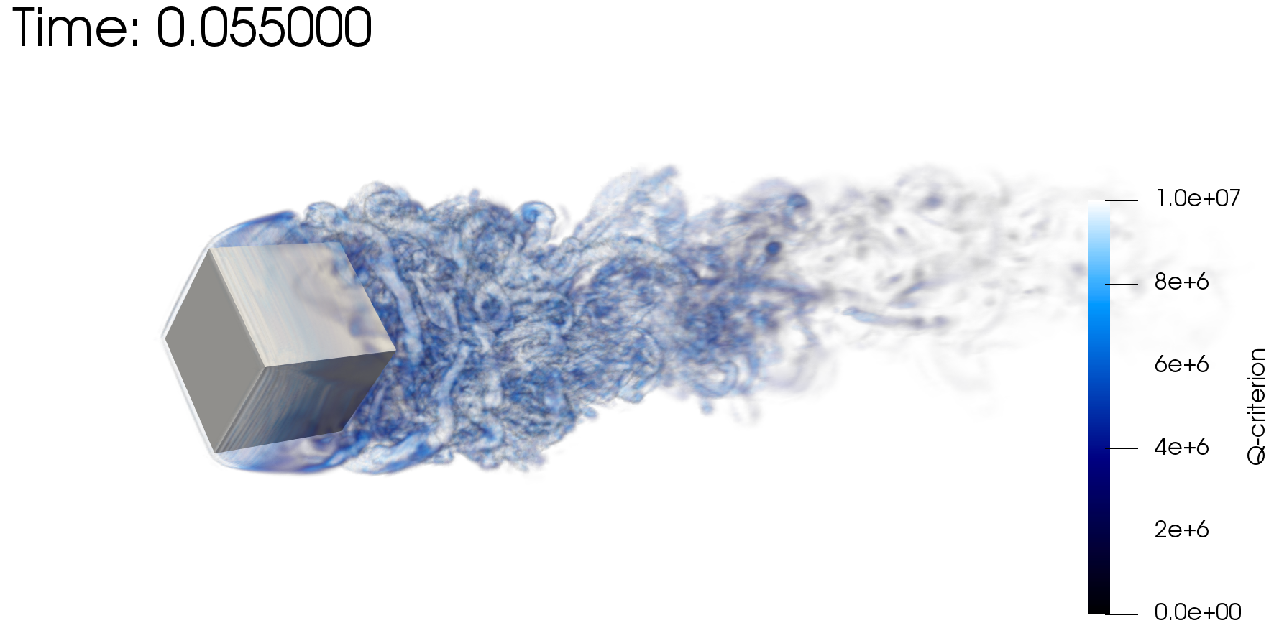
Baseline: Nalu, a Generalized, Unstructured Numerical Formulation
Objective: Scalable, Efficient fluids on hybrid-based mesh constructs
Rotating cube (Re 4000, RPM 3600)
P=1 (top) and P=2 (bottom)
CVFEM can be viewed as Petrov-Galerkin method (basis differs from test function)
High-quality on generalized unstructured meshes, Domino et al. Comput. Fluids (2019)
The method can also be promoted in polynomial space, see Domino, CTRSP (2014) as a first example of low-Mach fluids algorithm – or Domino, J. Comp. Phys. (2018)
GPU, Knaus, Comput. Fluids (2022)
Control-volume finite-element method (CVFEM)

Slide 12
Baseline: Nalu, a Generalized, Unstructured Numerical Formulation
Objective: Scalable, Efficient fluids on hybrid-based mesh constructs
Rotating cube (Re 4000, RPM 3600)
P=1 (top) and P=2 (bottom)
CVFEM can be viewed as Petrov-Galerkin method (basis differs from test function)
High-quality on generalized unstructured meshes, Domino et al. Comput. Fluids (2019)
The method can also be promoted in polynomial space, see Domino, CTRSP (2014) as a first example of low-Mach fluids algorithm – or Domino, J. Comp. Phys. (2018)
GPU, Knaus, Comput. Fluids (2022)
Control-volume finite-element method (CVFEM)

Slide 13
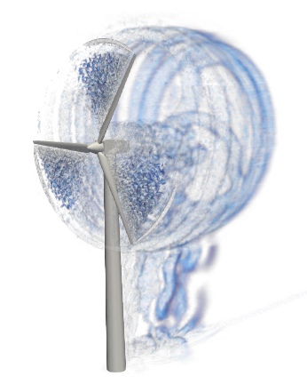
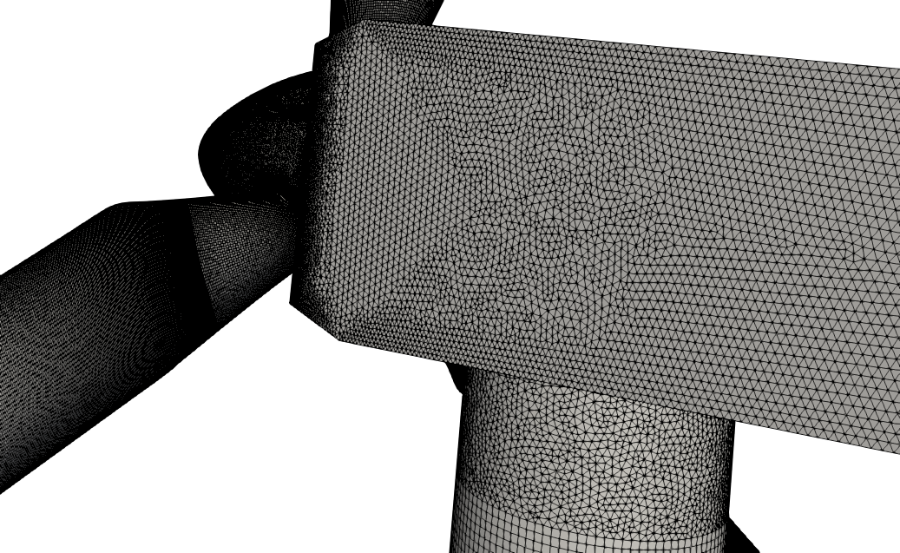

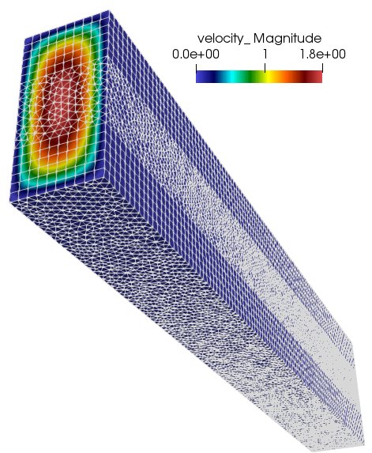
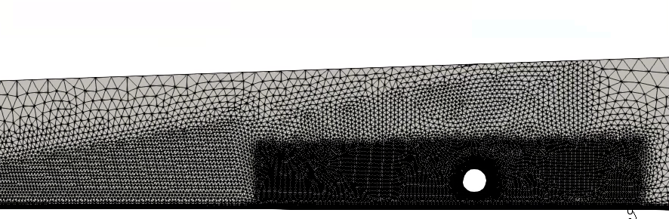
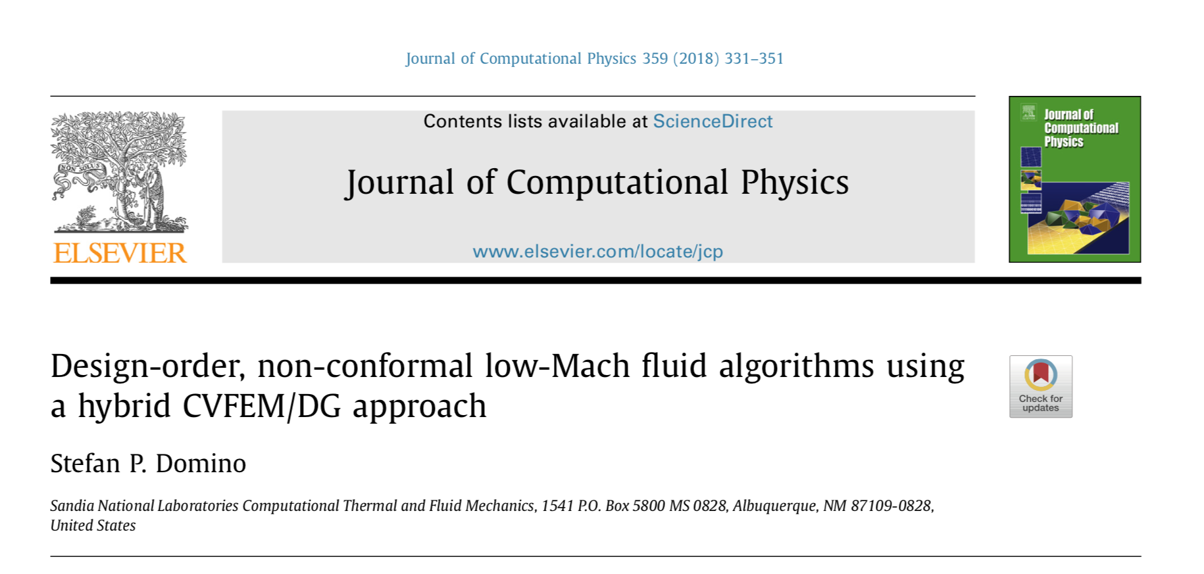
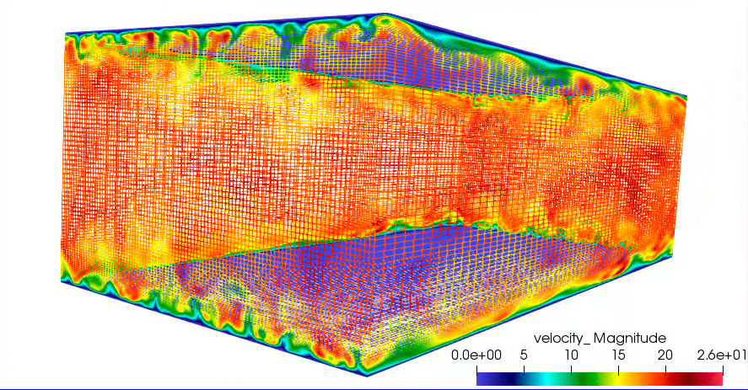
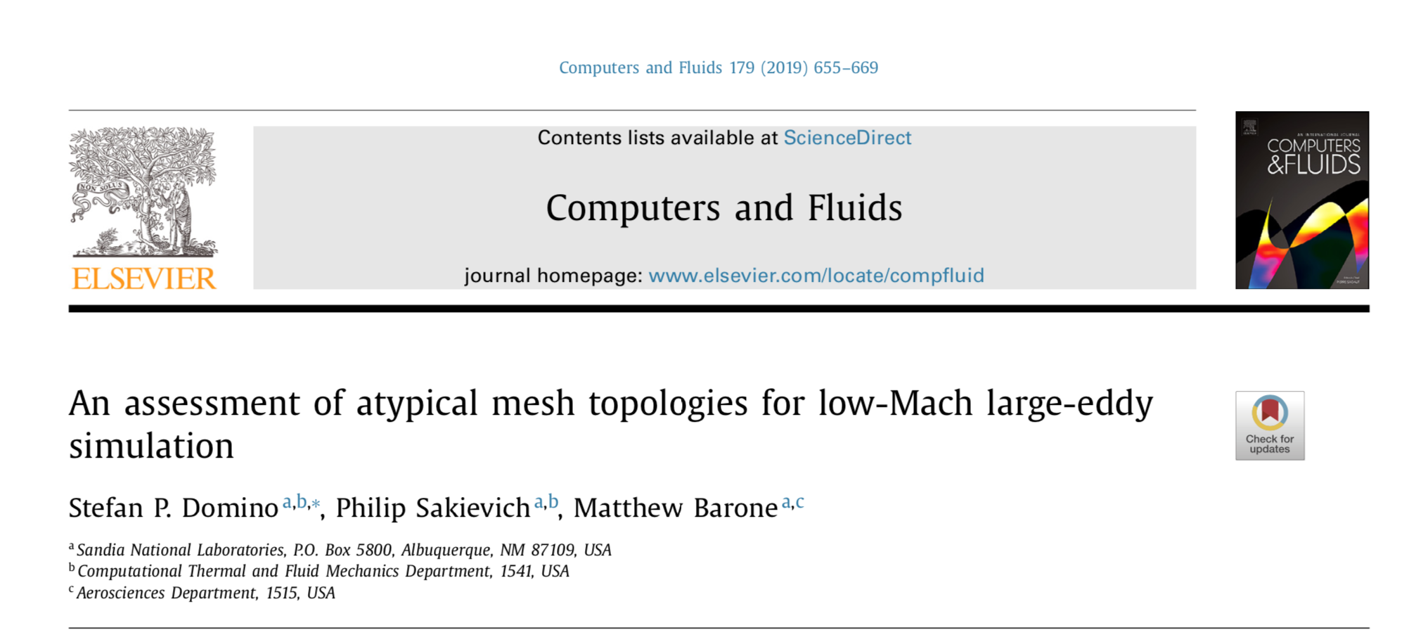
Confidence Established for Atypical Element Types
Verification
Validation

Slide 14
Equal-Order Interpolation, i.e., Collocation: Pressure Stabilization Review (1/2)
A variety of forms/explanations – depending on the particular community; at it’s base:
What is ? (next slide)?
Projected nodal gradient that
can be mass-lumped

Slide 15
Equal-Order Interpolation, i.e., Collocation: Pressure Stabilization Review (2/2)
is a function of the fine-scale momentum residual (evaluated at an integration point):
We can also project this residual to the nodes, and approximate R^{h}(u_{j}) as re-interpolation of choice terms
Usage of a full residual (1) results in a classic Pressure Stabilized Petrov Galerkin (Hughes et al. 1986)
Pick and choose each residual, Majumdar (1988)
Algebraically manipulation affords the classic Rhie-Chow-based (1983) pressure stabilization
- shown to be stable and dissipative [Ham and Iaccarino (2004) or Domino (2006)]
There is also the nuance of pressure projection vs monolithic (for another day!)
(1)

Slide 16
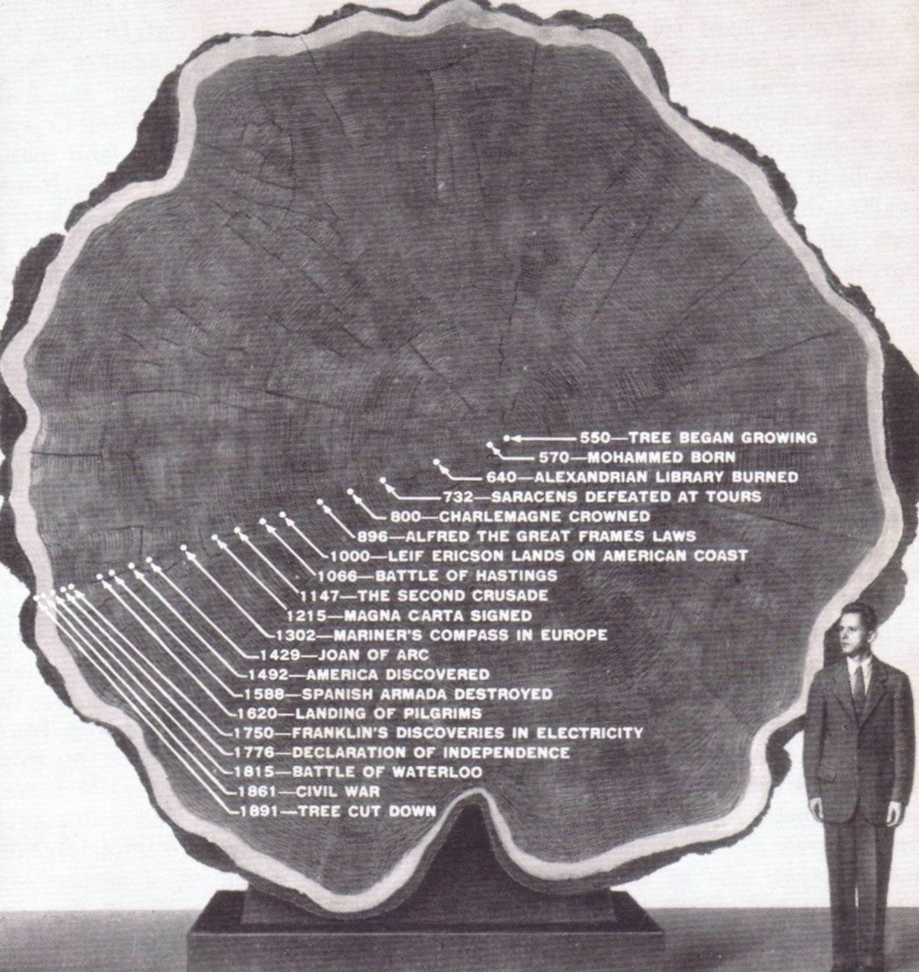
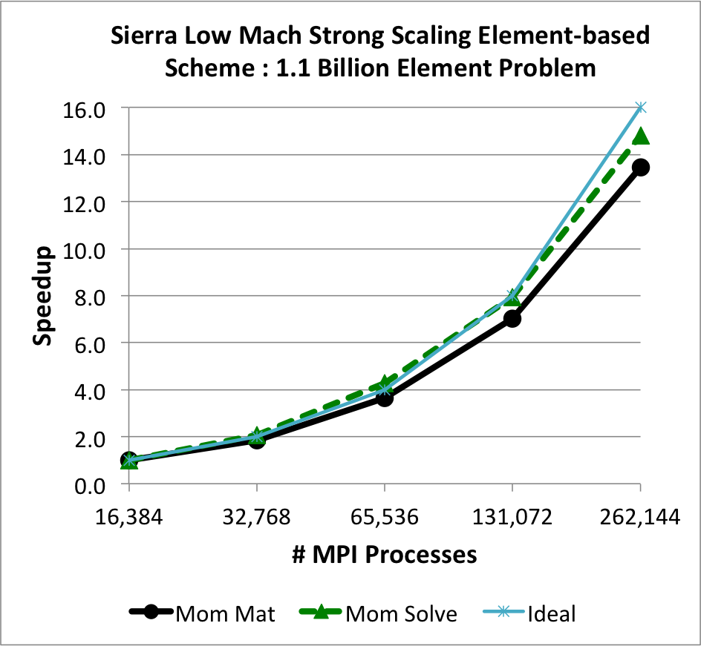
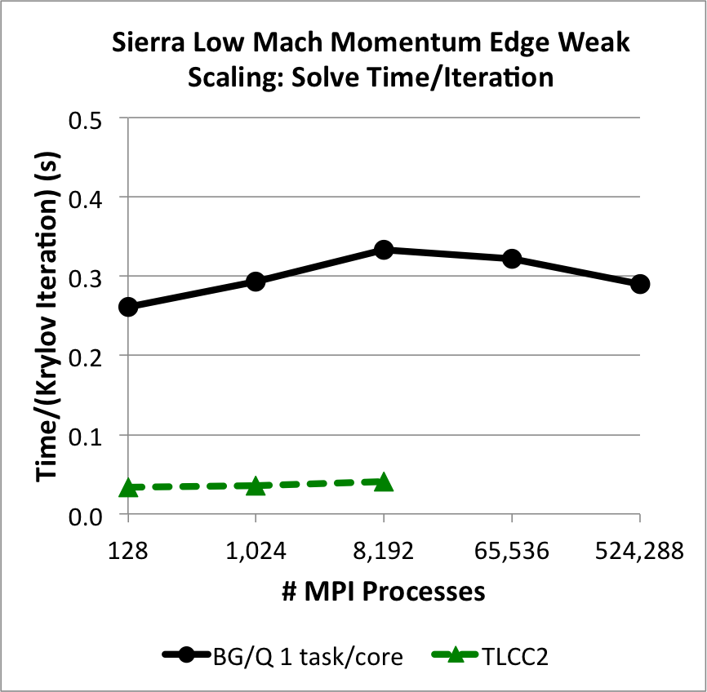
High Performance Computing (HPC): Enabling Scientific Advancement
Late Roman Timeline 250 AD - 300 AD
250 AD: The Goths invade Anatolia (AKA, Asia Minor), in sea-borne raids they plunder Nikopolis
Trinity open-science Domino and Barone, SAND2016-4085C (2016) to elucidate stall cells
O(6) billion element wind energy application (high-Re flow past thick blade in high AoA
O(128,0000) core run for ~one week ~1800 year simulation using computing resources available 10-years ago: Complete in roughly 29 years!
Recent impinging jet study: 200,000,000 CPU hours (~23,000 years)
25C, 100C, 300C, and 600C case run on 2000-4000 nodes (32 and 64 mpi ranks/node)
GPU-based approaches now emerging
A giant at redwood tree illustrating the passage
of time within its’ growth rings
Lin et al., Parallel Proc. Letters, (2014)

Slide 17
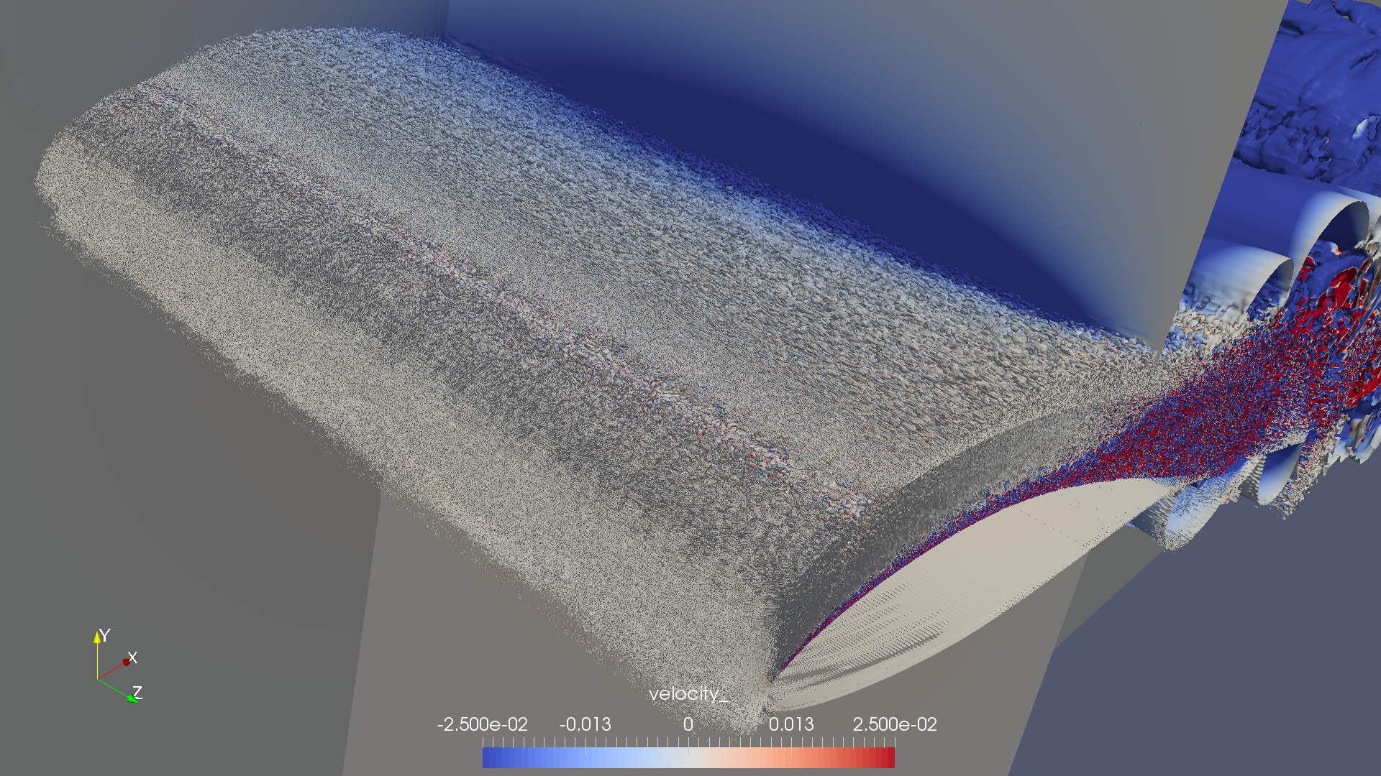
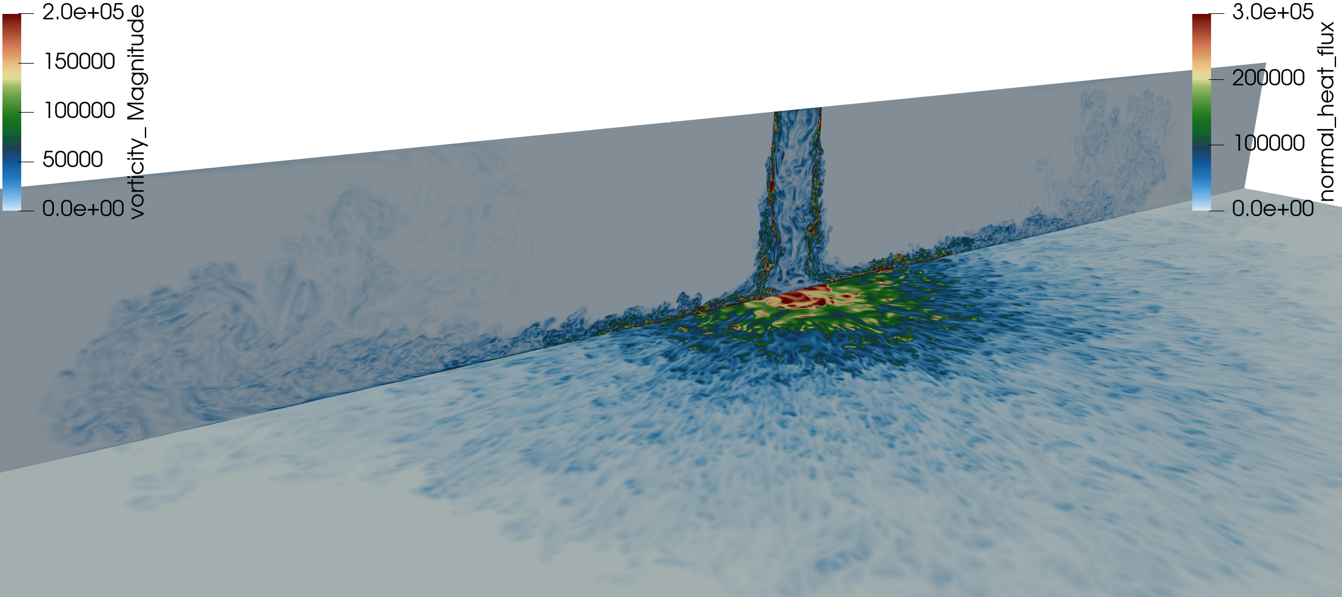
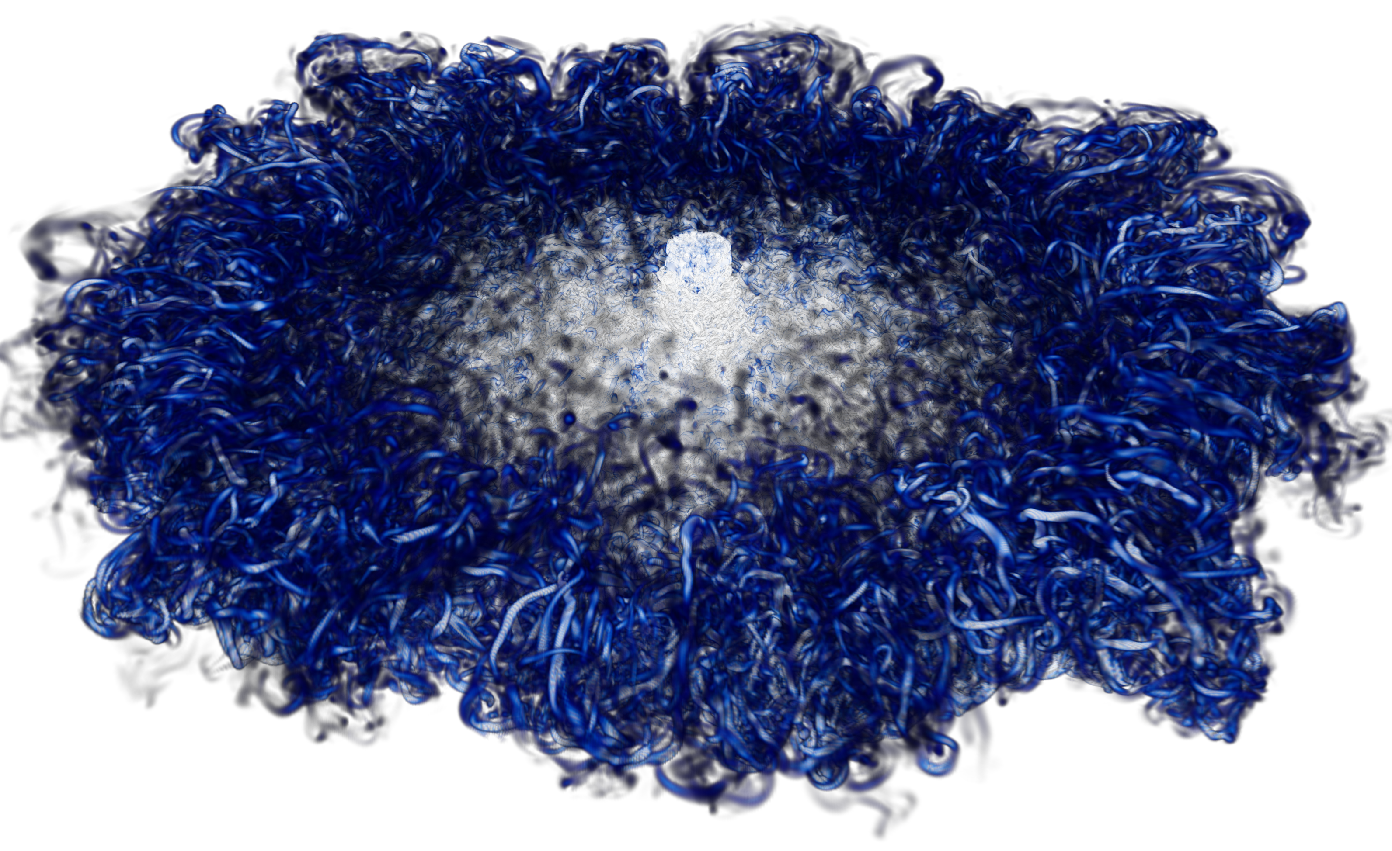
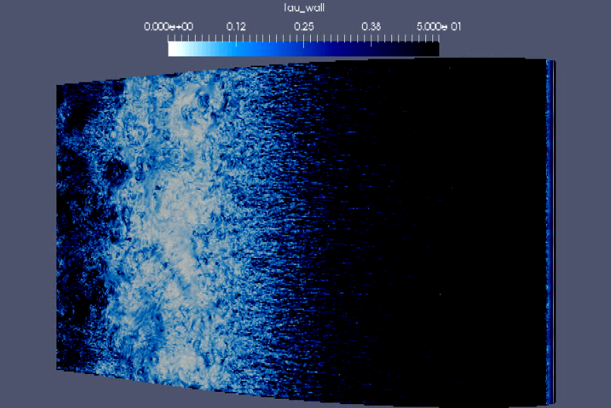
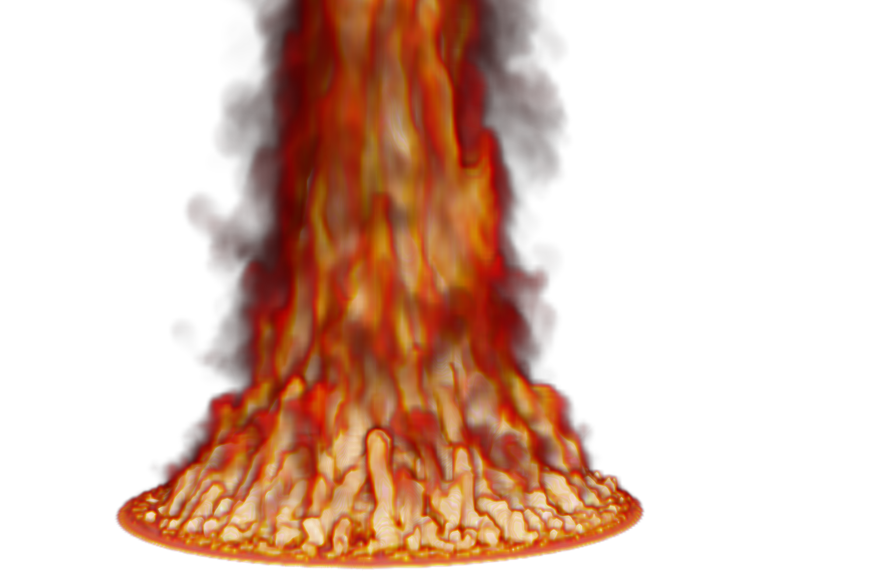
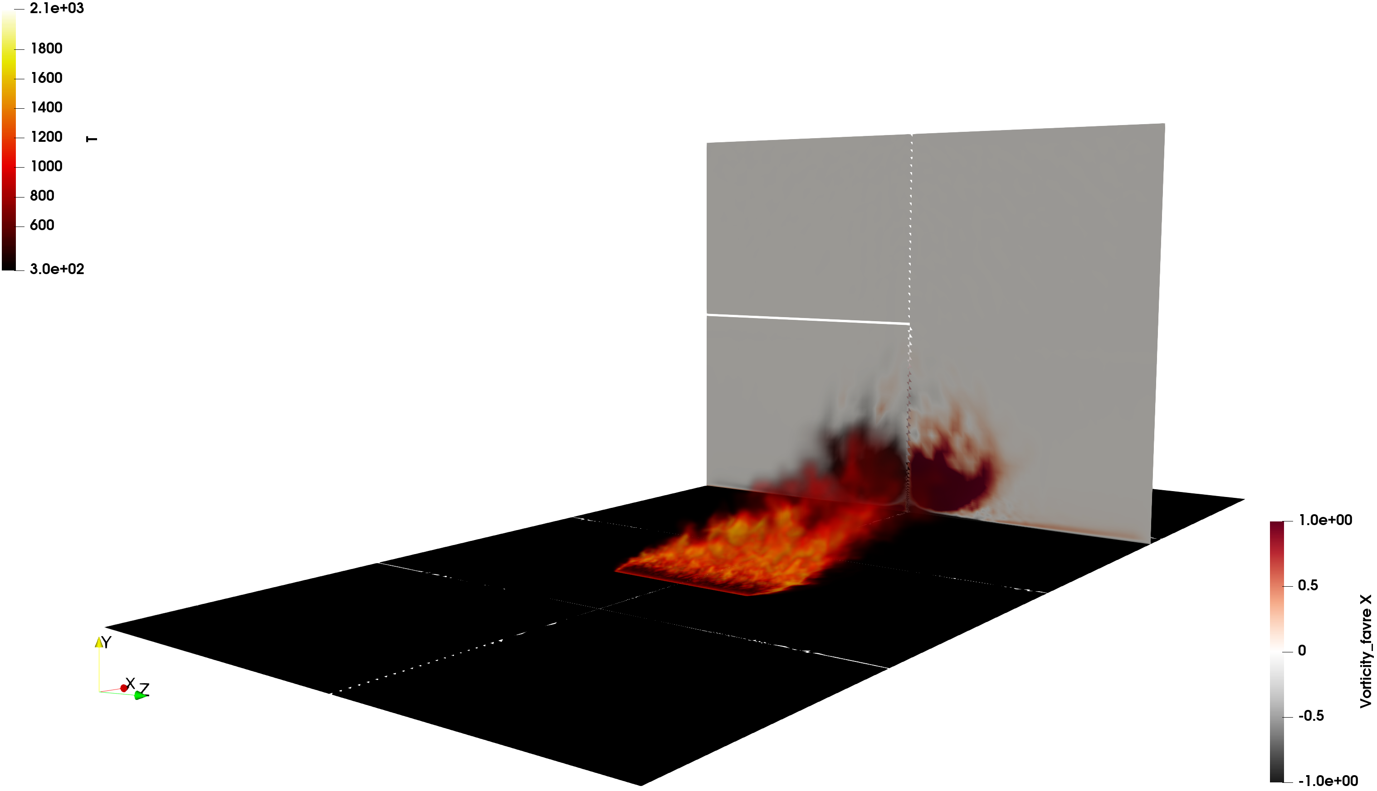

Routine Examples of HPC Centering Sandia’s low-Mach Capability
O(2) billion DNS impinging jet, velocity (vertical) and heat flux; Q-criterion
O(6) billion wind energy application
O(200) million multi-physics fire

Slide 18
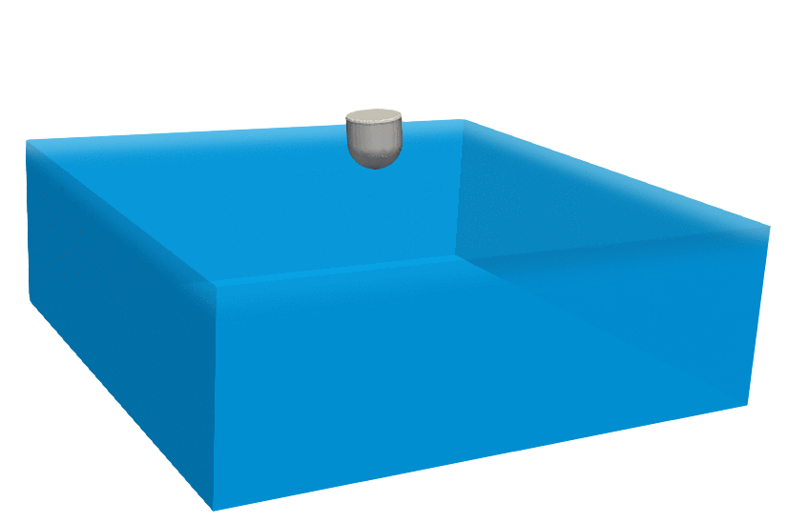
WEC Unique Challenges
While multi-physics coupling (thermal radiation, conjugate heat transfer, etc.) is absent, many new challenges exist including:
Floating, moving object
Multiphase volume of fluid equation:
0 in air, 1 in water
Equation lacks diffusion, thereby driving sophisticated stabilization approaches
Object’s trajectory is not known a priori
Six degree-of-freedom coupling infrastructure
Given a surface force, how does the object move?
Changing mesh connectivity that requires:
Parallel searches
Linear solver connectivity re-initialization
Preconditioner re-initialization
Wave energy converter (WEC) buoy drop
Coe et al., SAND2016-10094

Slide 19
VOF Transport Discretization Nuance: Volume- or Surface-based?
Simple enough, define the volume (fraction) of fluid (absent evaporation):
Option 1: volumetric-form:
Option 2: divergence-form:
CVFEM/FEM (really, any element-based approach)
Evaluated as a volumetric-contribution (diamonds)
Gauss-Divergence
Traditional finite volume (element, edge, cell-centered)
Evaluated as a surface integral (triangle)
Allows for a consistent advecting velocity (mass conserving)
that is obtained from the continuity equation

Slide 20
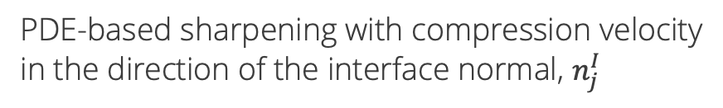
VOF Transport: Sharpening + Advection Stabilization + Interface Smoothing
VOF equation with PDE-based sharpening (to mitigate numerical diffusion) that includes novel residual-based stabilization, Domino and Horne, Renew. Energy, (2022)
Integrated-by-parts advection to allow for consistent continuity constraint; R^{h}(α)
PDE-based sharpening with compression velocity
in the direction of the interface normal, $n_{j}^{I}$
Streamwise-upwind, control volume (SUCV), Swaminanthan et al., Int. J. Numer.
Meth. Engr. (1993); based on Streamwise Upwind Petrov-Galerkin (SUPG),
Brooks and Hughes, Comput. Methods in Appl. Mech. Eng. (1982).
Nonlinear stabilization operator (NSO); Motivated by Shakib et. al, Comput.
Methods in Appl. Mech. Eng. (1991), discontinuity capturing operator
(later termed NSO); ν^{h} = f(R^{h}(α)) NSO and SUCV avoids common gradient
reconstruction techniques commonly used in unstructured formulations, see
Tsui et al., Int. J. Heat Mass Trans. (2009)
Nuance: interface normal can be computed using a smoothed VOF field

Slide 21
VOF using Balanced Force: Leveraging Existing Approaches
Generalized, unstructured, follows Lin et al, J. Comput. Phys. (2019) CVFEM approach
Classic Balanced Force, Francois, J. Comput. Phys. (2006) ported to CVFEM
Parasitic currents suppressed via a consistent momentum/continuity stabilization form: fine-scale momentum residual algebraically modified in continuity equation
Note: not trying to pioneer a novel balanced force approach (although this is planned)
Nodal pressure gradient
Momentum Equation
Convecting-velocity
Continuity Equation
Note: benefits from ρg_{i} (γ = 1) included in stabilization

Slide 22
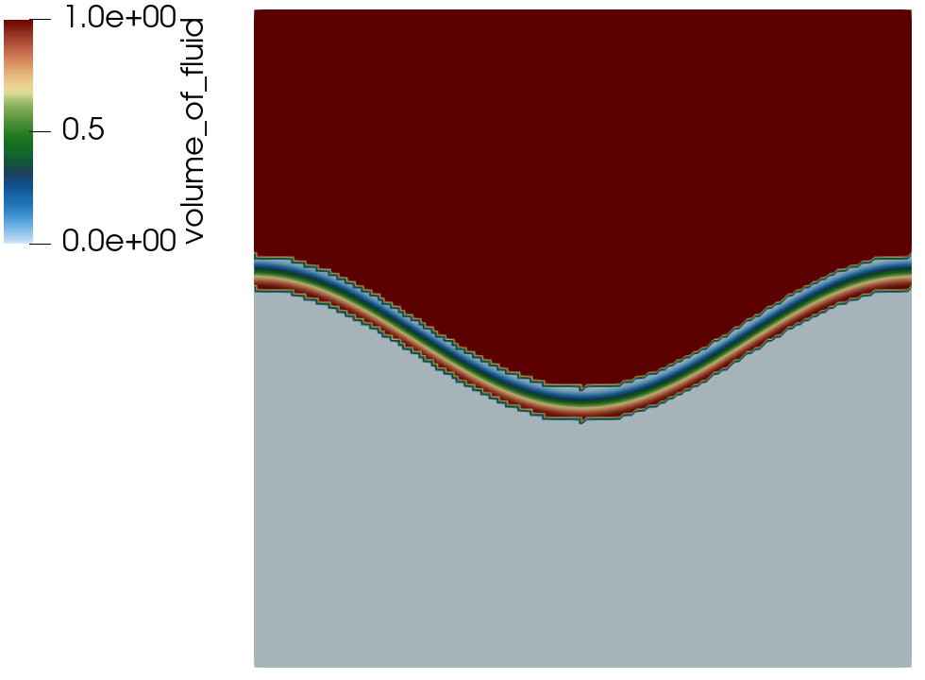
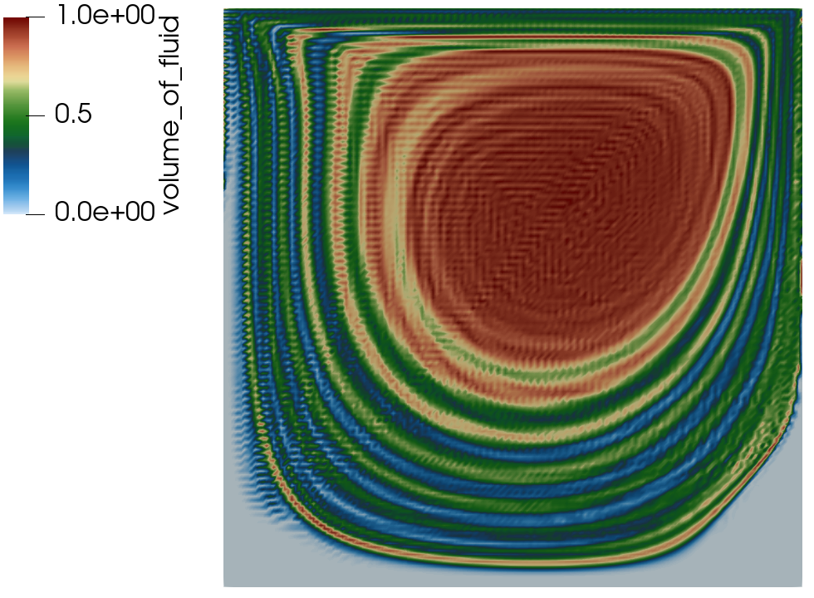
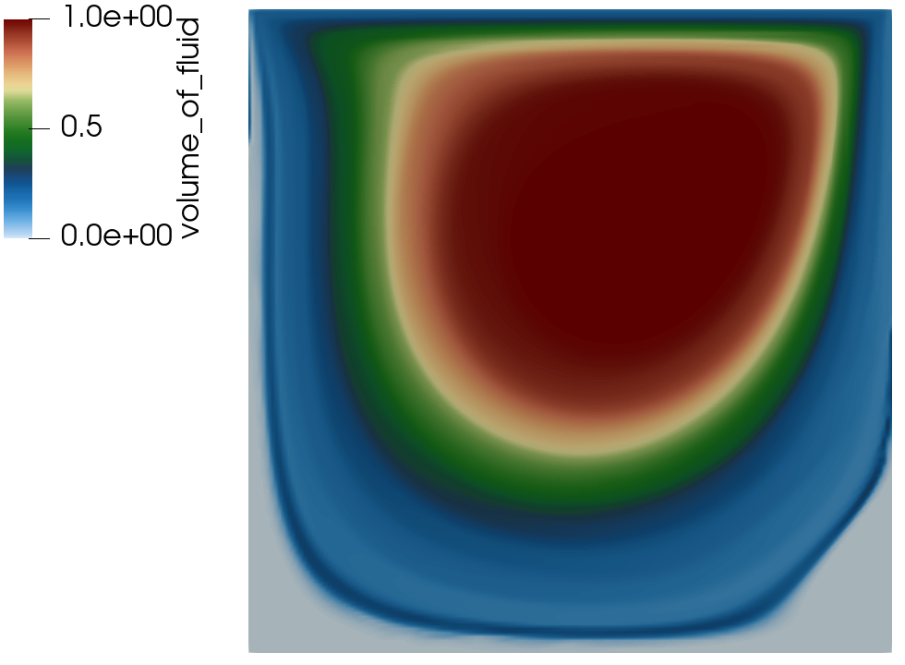
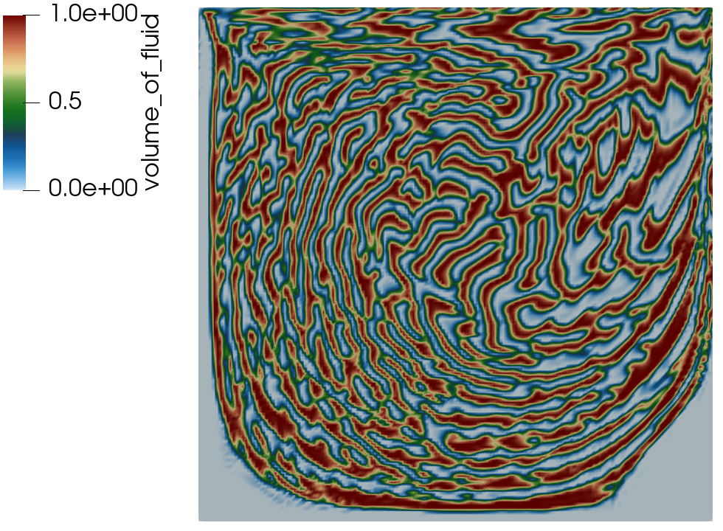
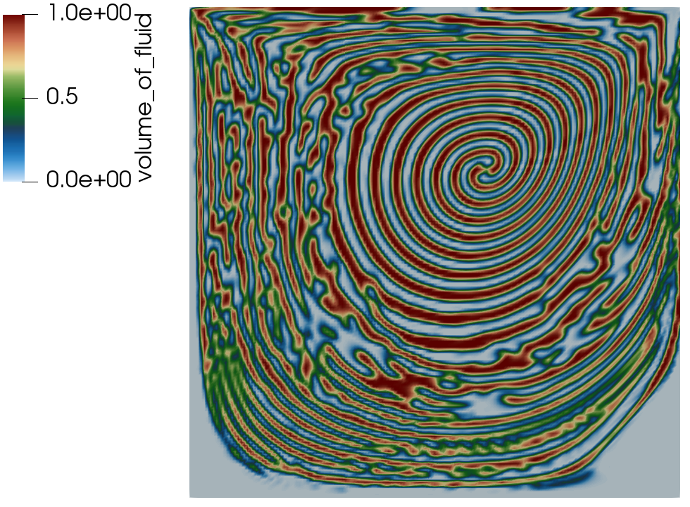
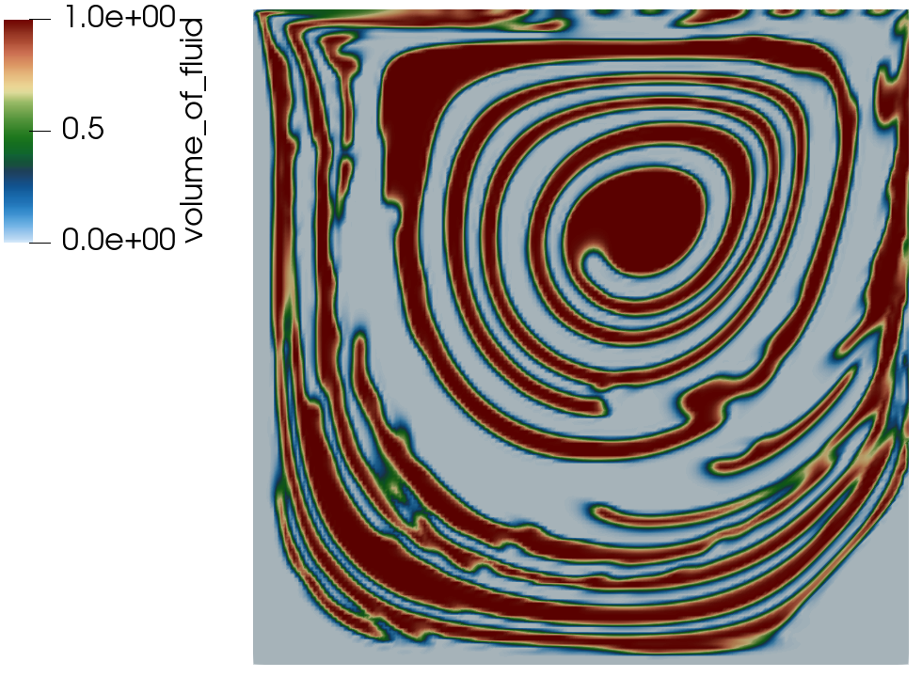
Passive Transport Example: Driven Cavity
Exploring PDE-based sharpening, interface smoothing and stabilization
Initial condition
No stabilization
SUCV+NSO
Sharpening+B
Sharpen+C
E+Smoothing
A B C
D E F

Slide 23
Residual-based stabilization
Molenkamp verification, see Martinez, Int. J. Numer. Meth. Engr. (2004), with a variety of stabilization options
Conformal mesh results
(stay tuned for overset)
First-order, upwind (FOUPW)
Second-order, UPW+Limit (SOUPW, limit)
SUCV, Polynomial-order = 1
SUCV, Polynomial-order = 2

Slide 24
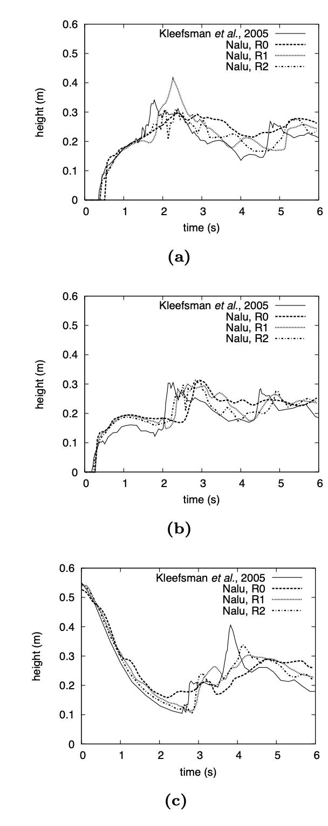
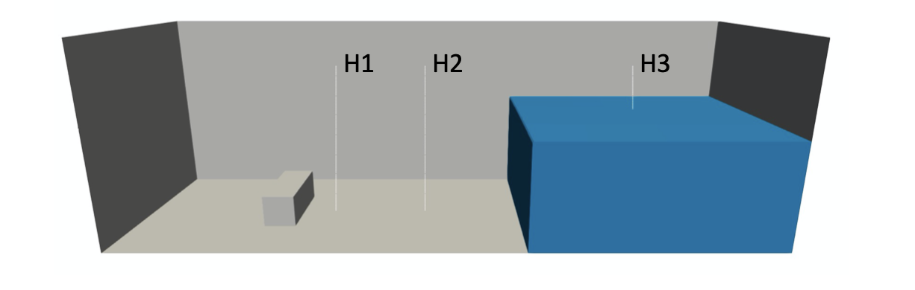
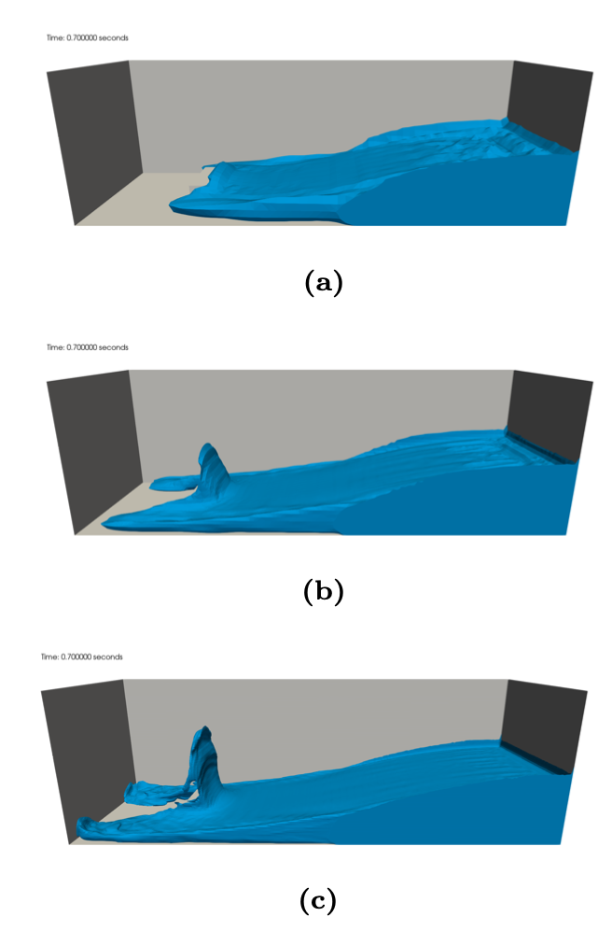
Dam Break Validation
H1
Validation case of Kleefsman et al. ”A volume-of-fluid based simulation method for wave impact problems”, J. Comput. Phys. (2005).
Qualitative comparisons also made to in-house effort in Fuego, Brown et al. “Modeling a rubble fire consisting of comingled liquid and solid fuel”, Tech. Rep. SAND2017- 12318C (2017).
R0
H2
R1
R2
H3

Slide 25
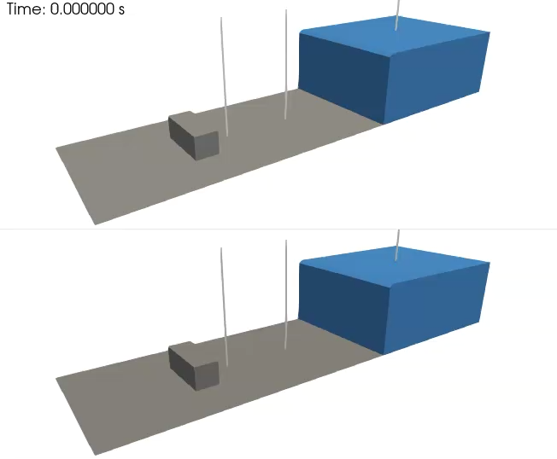
Dam Break Validation: The Benefit of a Full Balanced-Force Method
Here, comparisons made between γ = 1 (top) and γ = 0 (bottom) showcasing the increased stabilizing effect of the set of all body forces in momentum included in the pressure stabilization formulation
A nuance briefly captured and/or hinted at in seminal Francois et al., J. Comput. Phys. (2006) effort
R0

Slide 26

Dam Break Validation: The Benefit of a Full Balanced-Force Method
Here, comparisons made between γ = 1 (top) and γ = 0 (bottom) showcasing the increased stabilizing effect of the set of all body forces in momentum included in the pressure stabilization formulation
A nuance briefly captured and/or hinted at in seminal Francois et al., J. Comput. Phys. (2006) effort
R2

Slide 27
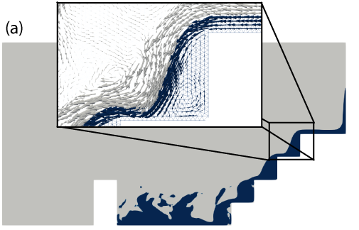
(Lab Directed Research and Development: “Increasing CO₂ Capture Rate in Liquid-Solvent Direct-Air Carbon Capture via Additive Manufacturing”)
Goal: Increasing CO2 Capture Rate in Liquid-Solvent Direct-Air Carbon Capture via Additive Manufacturing Rodgers, PI (1864)
Project plans to create support material with surface features at similar length scales as the film thickness to increase mixing and CO₂ absorption.
Additive Manufacturing produces material with inherently rough surfaces and allows for rapid exploration of designed surface morphologies.
Featured surfaces have demonstrated increases in turbulence and heat transfer. CO₂ absorption not yet explored.
Validate the hypothesis that microscopic surface features improve mixing of fluid films in DAC conditions and result in increased CO₂ uptake using experimental and computational approaches
Proof-of-concept cascading exploration

Slide 28
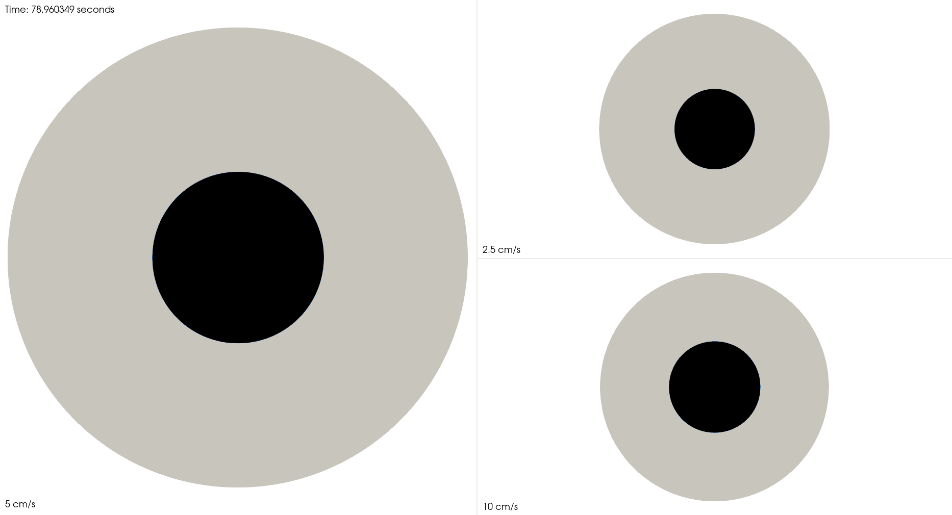
(Lab Directed Research and Development: “Increasing CO₂ Capture Rate in Liquid-Solvent Direct-Air Carbon Capture via Additive Manufacturing”)
Goal: Increasing CO2 Capture Rate in Liquid-Solvent Direct-Air Carbon Capture via Additive Manufacturing Rodgers, PI (1864)
Project plans to create support material with surface features at similar length scales as the film thickness to increase mixing and CO₂ absorption.
Additive Manufacturing produces material with inherently rough surfaces and allows for rapid exploration of designed surface morphologies.
Featured surfaces have demonstrated increases in turbulence and heat transfer. CO₂ absorption not yet explored.
Validate the hypothesis that microscopic surface features improve mixing of fluid films in DAC conditions and result in increased CO₂ uptake using experimental and computational approaches
Proof-of-concept cascading exploration
Evaporation as well, below a steady pool
fire size at various inventory leaks

